Slide 1
Application Development
Instructor: Kazi Amit Hasan

Slide 2
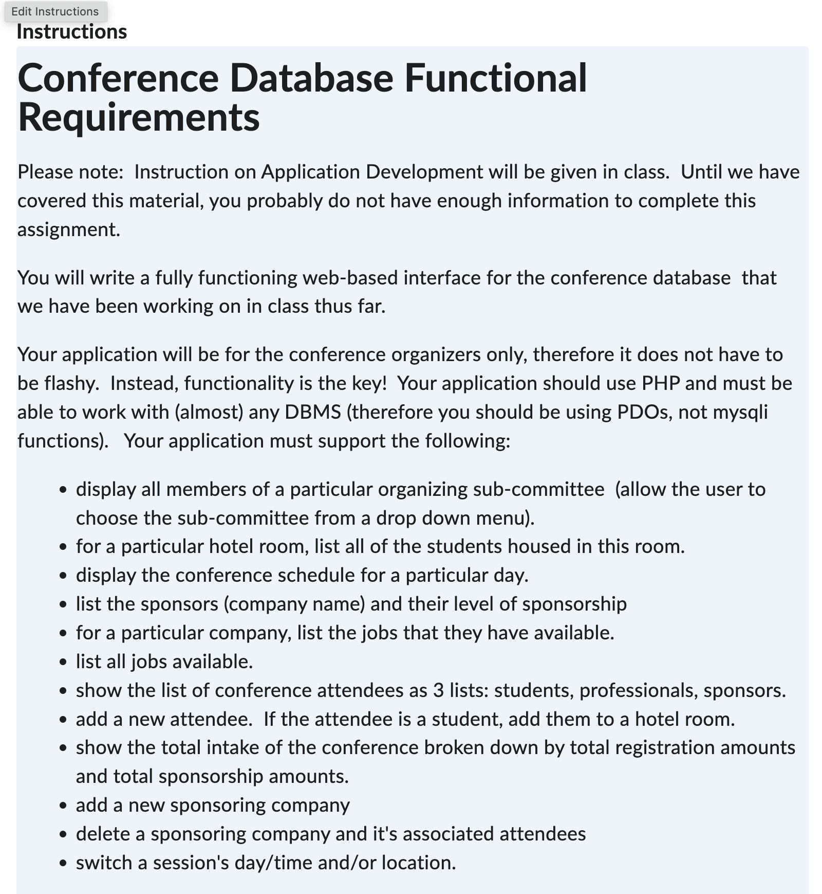
Web Application (Part 3)
Doesn’t need to be flashy
Functionality is the key
You should use PHP
You application must support the mentioned items
You must use PDO
Deliverables:
3-5 min video which show all the functionality and demonstrate that your program works
It should walk through the functionality.
Zip all your codes and submit in onq
Scirpt that you use for creating DB and loading data

Slide 3
Web Application (Part 3)
Reference 1: https://www.youtube.com/watch?v=TH0swGFzFxA
Reference 2: https://www.youtube.com/watch?v=PeUEeHX_8Xo

Slide 4
Things we will learn
HTML
CSS
PHP

Slide 5
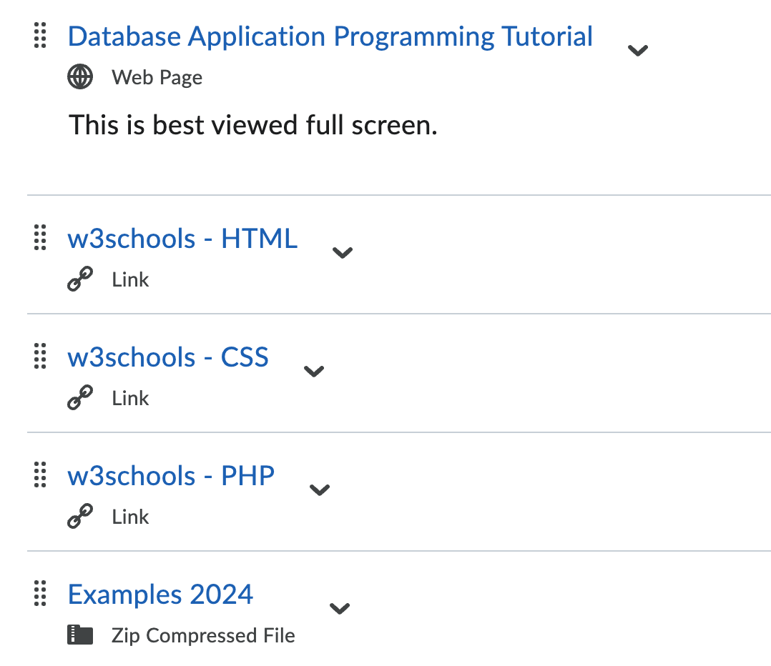
Learning Materials
Tutorial by Wendy Powley in OnQ
W3 school resources
Sample project (different)

Slide 6
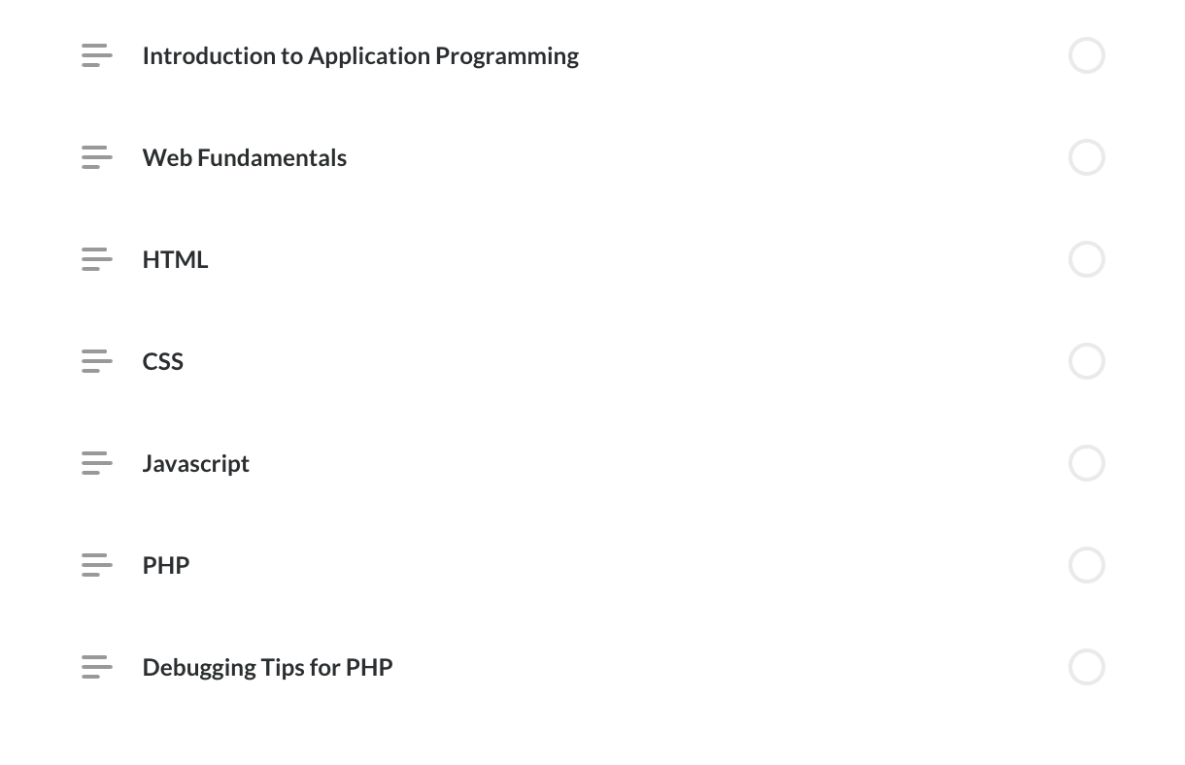
This week’s agenda

Slide 7
Introduction to Application Programming
What we have learned?
Design a database
Build a database
Add/update in database
Write sql queries
Databases are accessed via application programs

Slide 8
Examples
ATM machines
SOLUS

Slide 9
Component of application program
Front end (user interface)
Back end (the communication with the database)
Middle layer (business logic)

Slide 10
Historically database applications ran on large mainframe computers
database accesses were made through programming language APIs or by embedding SQL within the code itself
We are not covering embedded sql concept in this course.
Popular methods of database access:
JDBC (Java database connectivity)
ODBC (Open database connectivity)

Slide 11
JDBC is an API for Java which allows for database access from within a Java program.
ODBC was a standard developed by Microsoft and Simba Technologies during the early 1990s
provides a standard programming API that allows any type of database management system to be accessed via a program
provides DBMS independence

Slide 12
The defacto standard for database access now (and in the past 15 years or so) is via a Web application
Web browsers are now the universal front end connecting to a back-end database via the internet.
Browsers use a standard syntax, HTML which supports pretty displays of information and form-based interfaces to gather information from the users.
Also fancy front ends

Slide 13
Next class
Learn about
Web fundamentals
HTML, CSS, JS, PHD

